Slide 1


Music Genre Classification: A Comparison
Supekar Unmesh Mahesh
2101208039

Slide 2
The flow…
Abstract
The Process
The Dataset: GTZAN
The Alternatives
Feature Extraction
Dataset Preparation
Feedforward NN
CNN
KNN
LSTM
The Codes
Findings & Conclusion: Comparison

Slide 3
Abstract
Machine-learning models and Convolutional Neural Network (CNN) were then trained and tested on ten GTZAN dataset genres. The k-Nearest Neighbours (kNN) provided the best classification accuracy at 92.69% on three-seconds duration input features.
Ref: Music Genre Classification using Machine Learning. Fourth International Conference on Electronics, Communication and Aerospace Technology (ICECA-2020)

Slide 4

The Process:
Audio
Feature extraction
Model Building
Model Training
Predict
Aap Chronology Samjhiye!

Slide 5
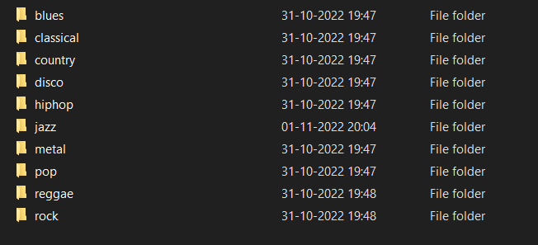
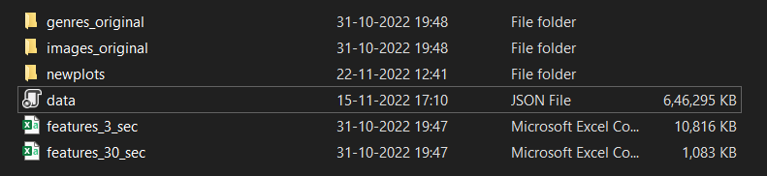
The Dataset: GTZAN

Slide 6
The Alternatives: Algorithms
Music Genre Classification
Chote Bacche
KNN
K-Means
Bade Bacche
Neural Networks
SVM
Random Forest classifier

Slide 7
The Alternatives: Methods
Music Genre Classification
Excel
3 Sec
30 Sec
Neural Networks
Image
Audio

Slide 8
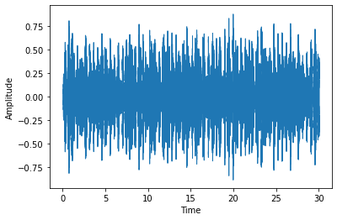
Feature Extraction: Waveplot
Notes:
3 levels of audio features : high mid and low , high can be experienced by humans like the chords, melody,rhythm. Mid can be perceived by humans like beats,pitch,fluctuations, mfcc. Low are the machine understandable features like amplitude, spectral centroid, zero crossing rate. These make sense to machine but not humans . Now MFCC

Slide 9
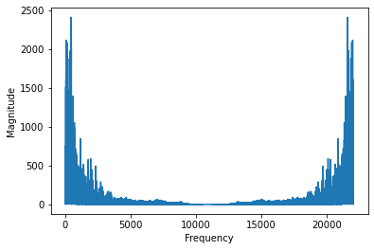
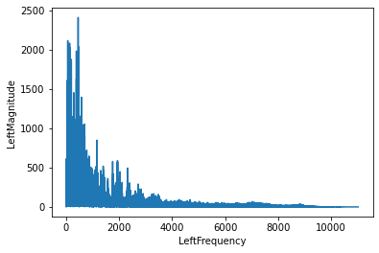
Feature Extraction: Frequency Plot

Slide 10
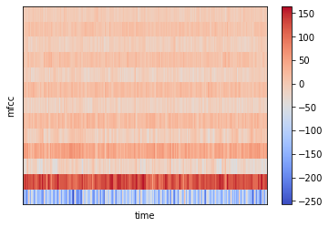
Feature Extraction: Spectrogram

Slide 11
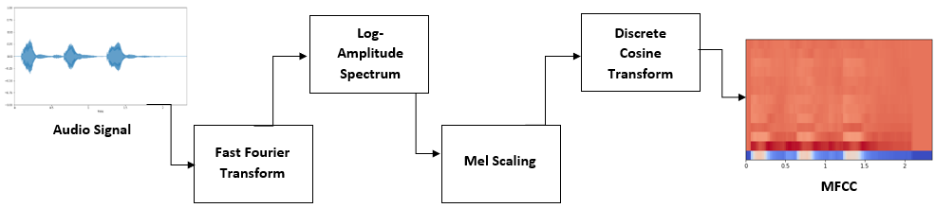
Feature Extraction:
MFCC

Slide 12
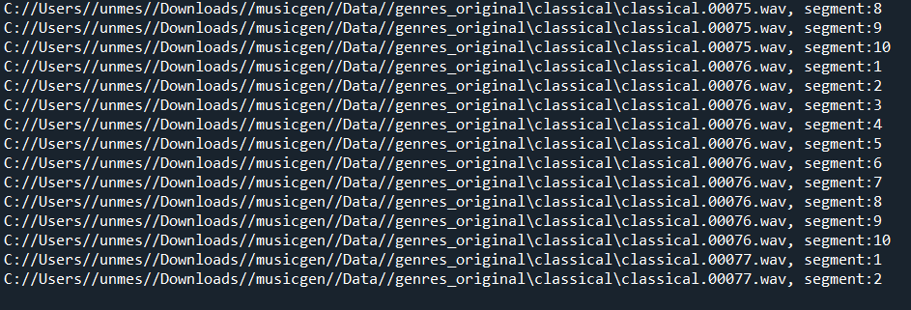
Dataset Preparation

Slide 13
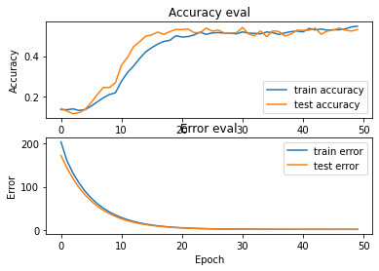
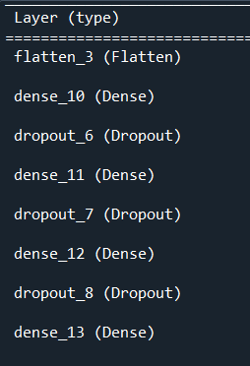
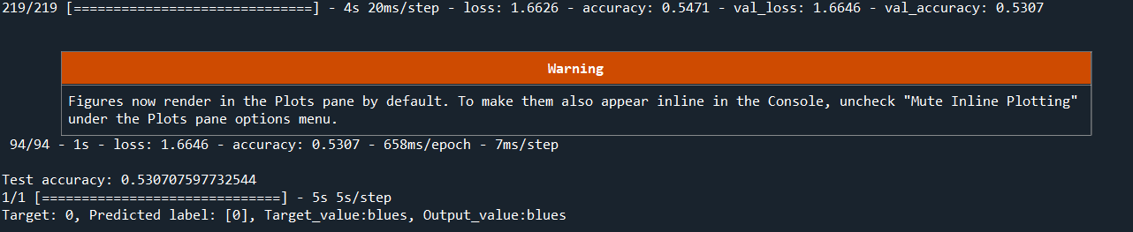
Feed Forward Neural Network

Slide 14
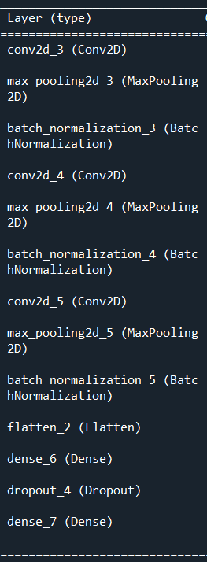
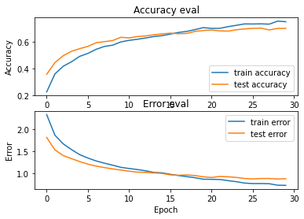
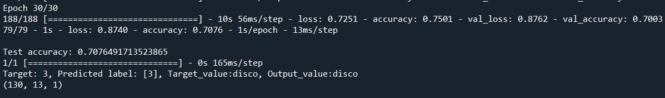
Convolutional Neural Network

Slide 15
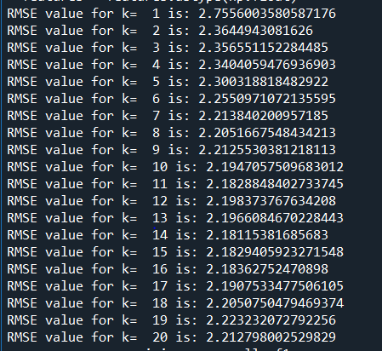
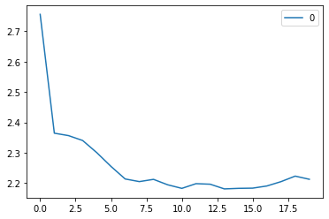
K-Nearest Neighbors
K=7,8

Slide 16
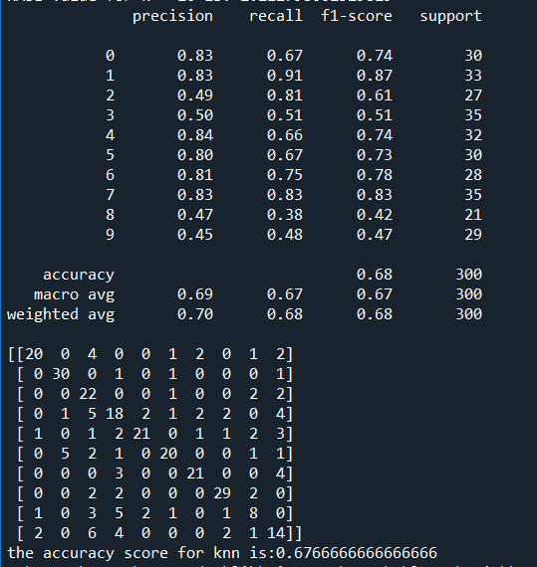
K-Nearest Neighbors

Slide 17
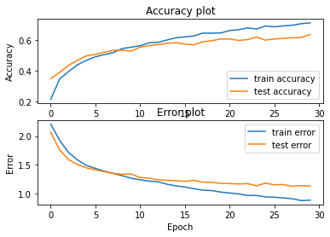
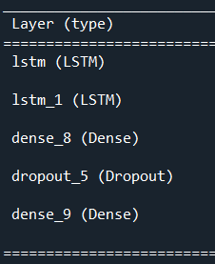
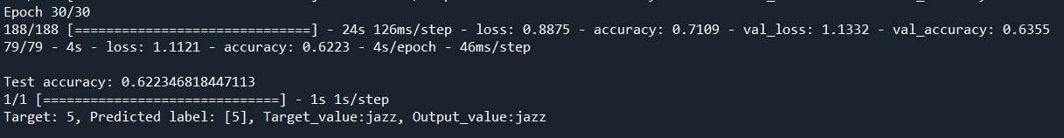
Long Short Term Memory

Slide 18
The Codes

Slide 19
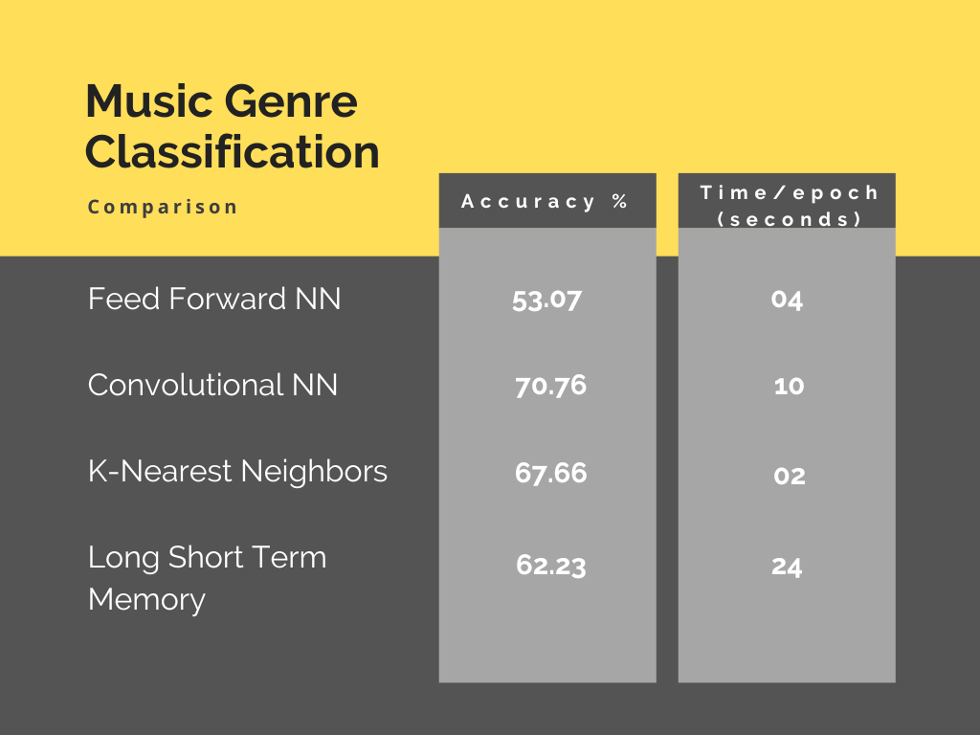
Comparison

Slide 20

Findings & Conclusion

Slide 21
Findings & Conclusion

Slide 22
1. CNN 2. K-Nearest Neighbors

Slide 23
Then which one is ‘The Best’ ??

Slide 24


To get rid off the roaches you use
&

Slide 25

Instead of..
- Mr. Kumarsanjay bhorekar

Slide 26
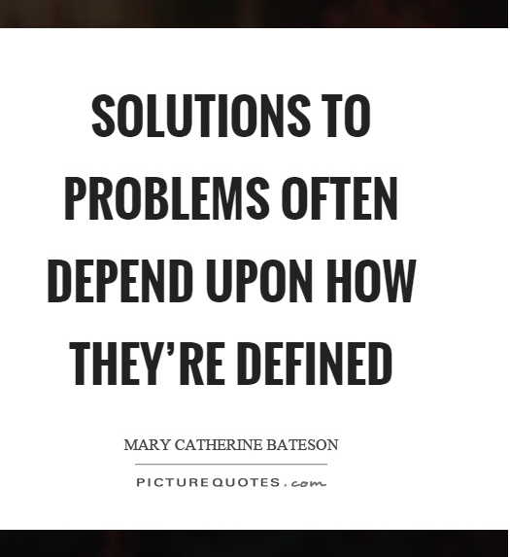
It’s all about Perspectives!

Slide 27


